Slide 1
CITY OF GRAPEVINE DALLAS ROAD TRANSIT DISTRICT
Scott Williams, Director of Development Services scottw@grapevinetexas.gov
Mark Brooks, Principal, Brooks Hospitality Consulting
mark@brooksshc.com
Bob Farley, Director of Economic Development bfarley@grapevinetexas.gov
http://grapevinetexas.gov/DocumentCenter/View/6273/Section-41B---Transit-District-Overlay

Slide 2
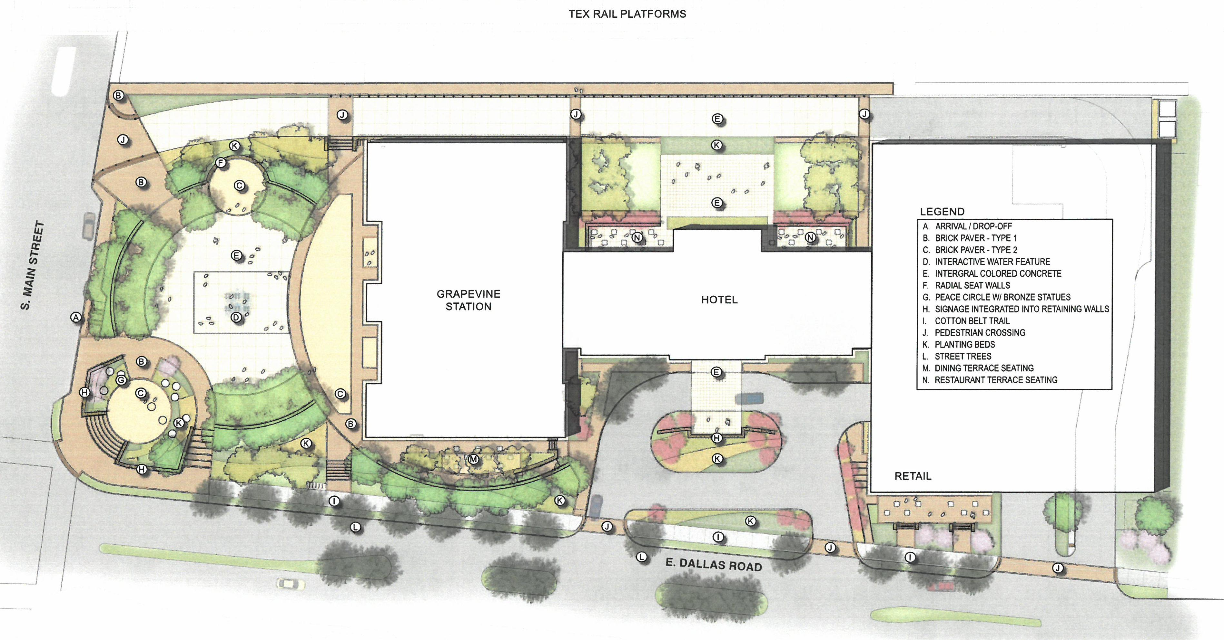
GRAPEVINE MAIN STATION/HOTEL VIN

Slide 3
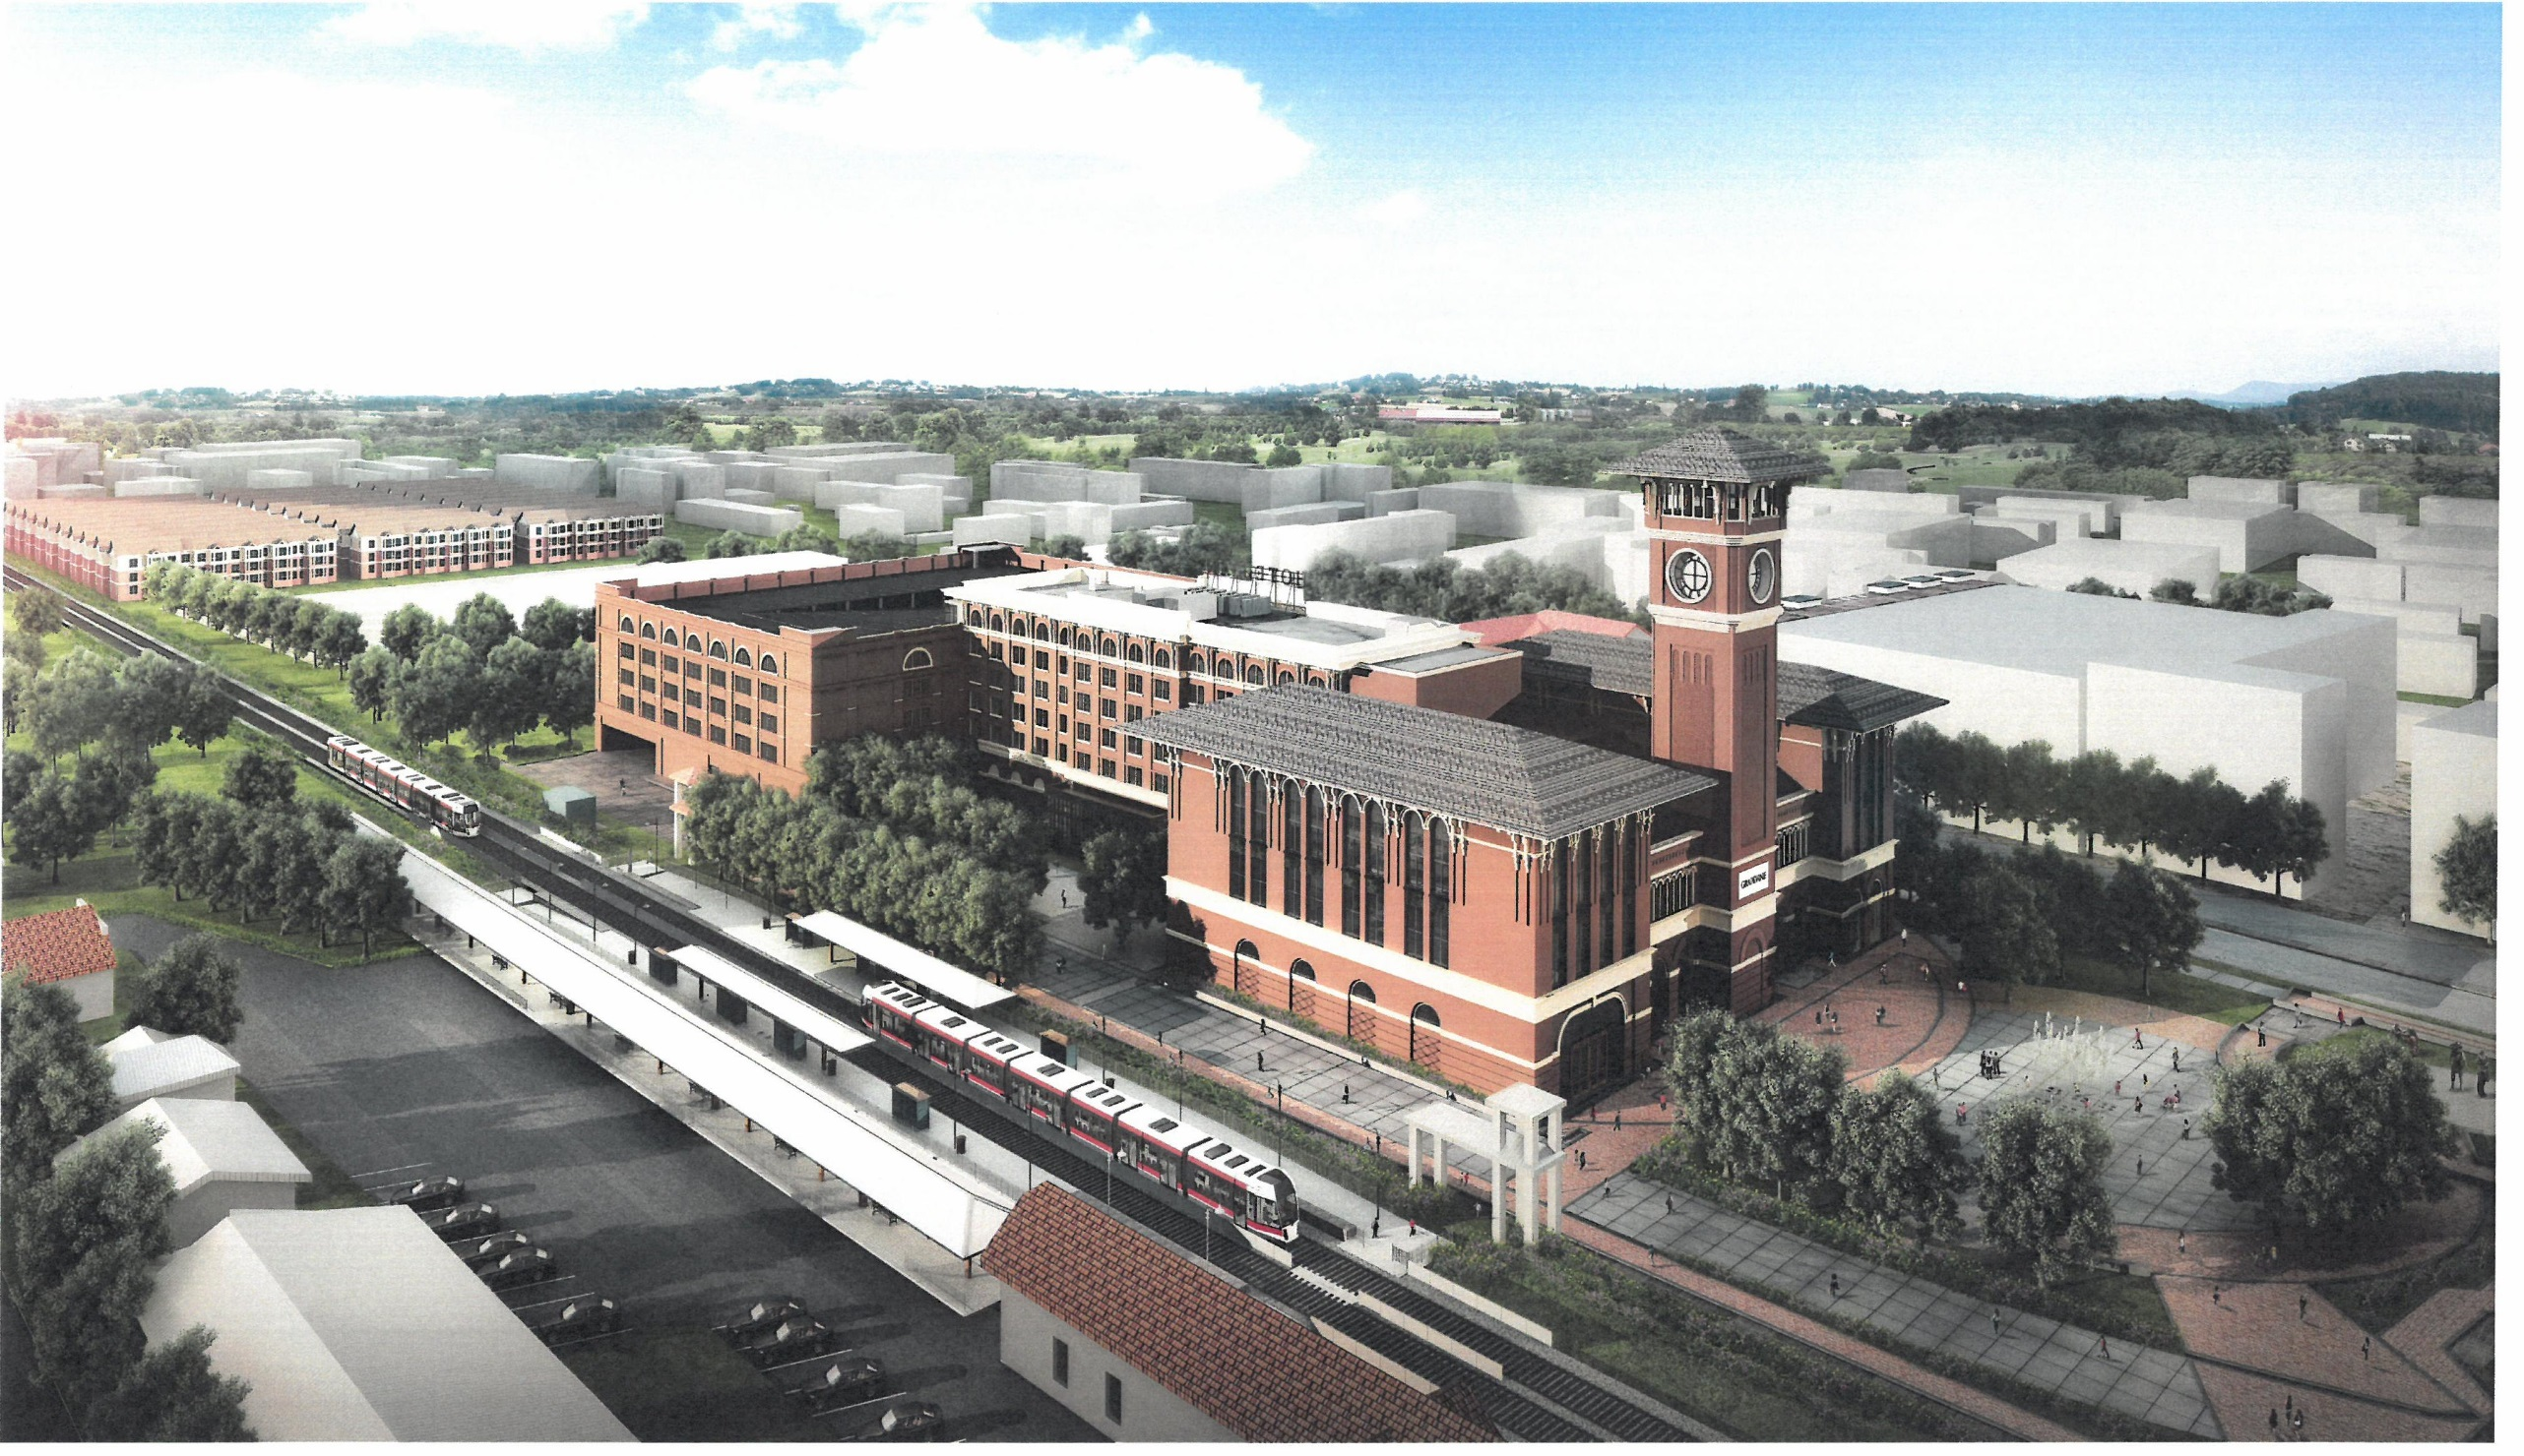
GRAPEVINE MAIN/HOTEL VIN

Slide 4
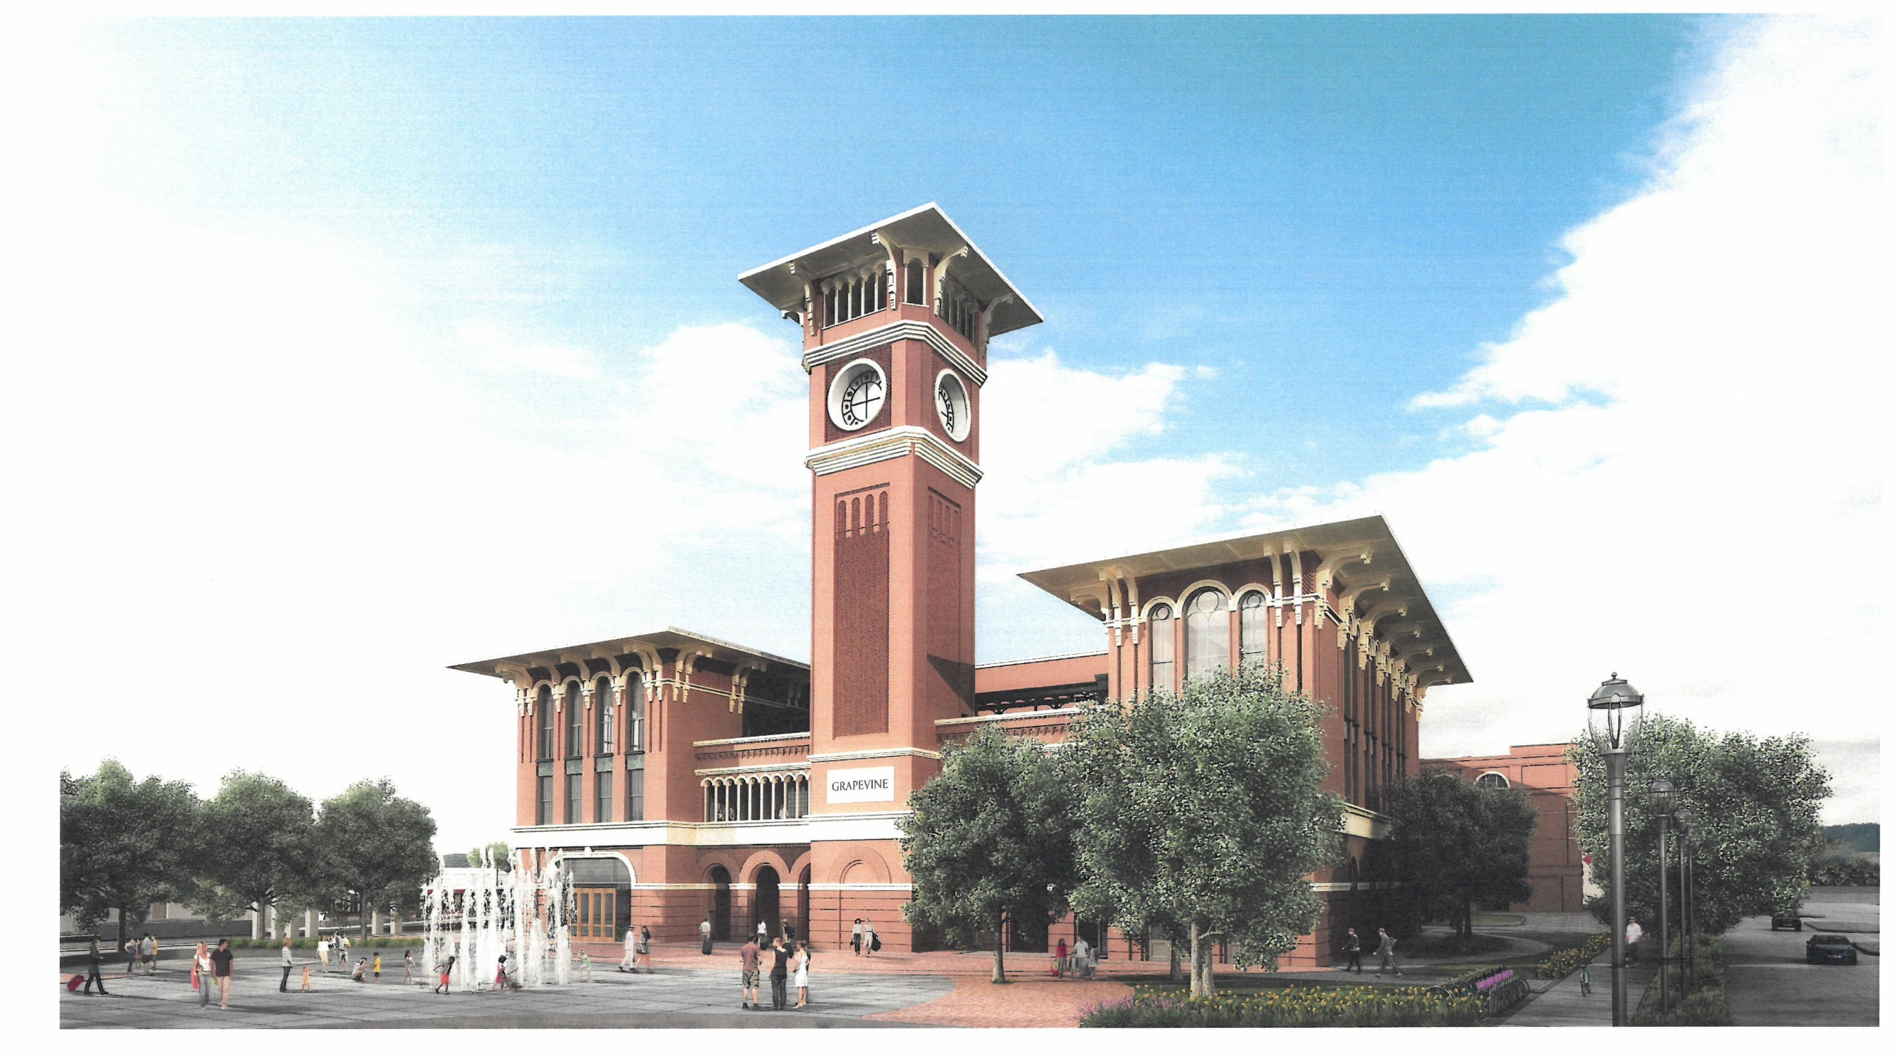
GRAPEVINE MAIN/HOTEL VIN

Slide 5
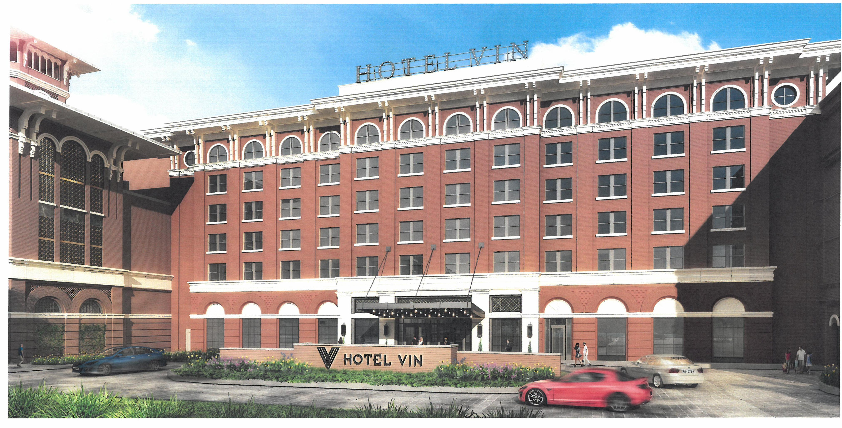
HOTEL VIN

Slide 6
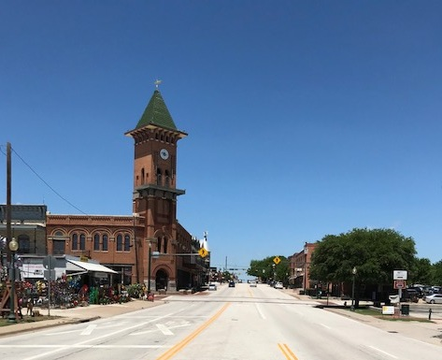
HISTORIC MAIN STREET LOOKING NORTH

Slide 7
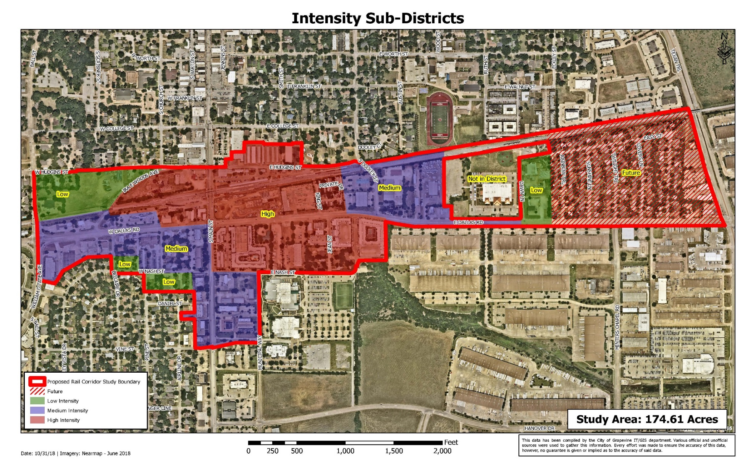
TRANSIT DISTRICT BOUNDARIES

Slide 8
EXCERPT FROM TRANSIT DISTRICT DESIGN STANDARDS
PREFERRED USE MATRIX*
 | Intensity Sub-District
 | High | Medium | Low
Entertainment | X
Attractions | X
Restaurant | X | X
Winery | X | X
Craft Brewery | X | X
Distillery | X | X
Retail | X | X
Artisan/Craft Studios & Shops | X | X
Temporary Retail (Vendors/Kiosks) | X | X
Mixed Use | X | X
Office | X | X
Personal Service | X | X
Educational/Vocational Institution |  | X
Live/Work Space | X | X
Condominium / Townhome | X | X | X
Single Family Attached | X | X | X
Two Family |  |  | X
Single Family Detached |  |  | X
*This is a summary of some of the more common possible appropriate uses; all uses will be approved through the Conditional Use process in accordance with Section 48 of the Grapevine Zoning Ordinance.

Slide 9
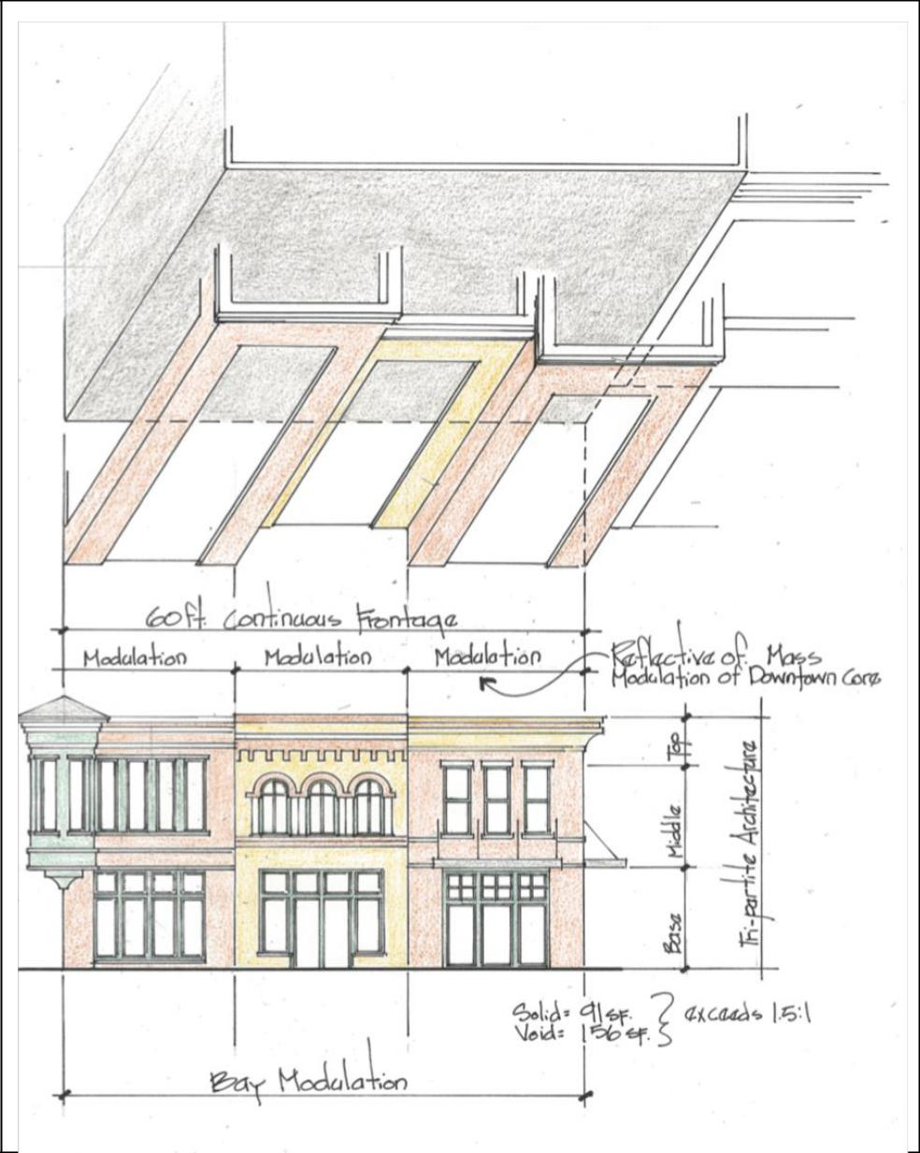
EXCERPT FROM TRANSIT DISTRICT DESIGN STANDARDS

Slide 10
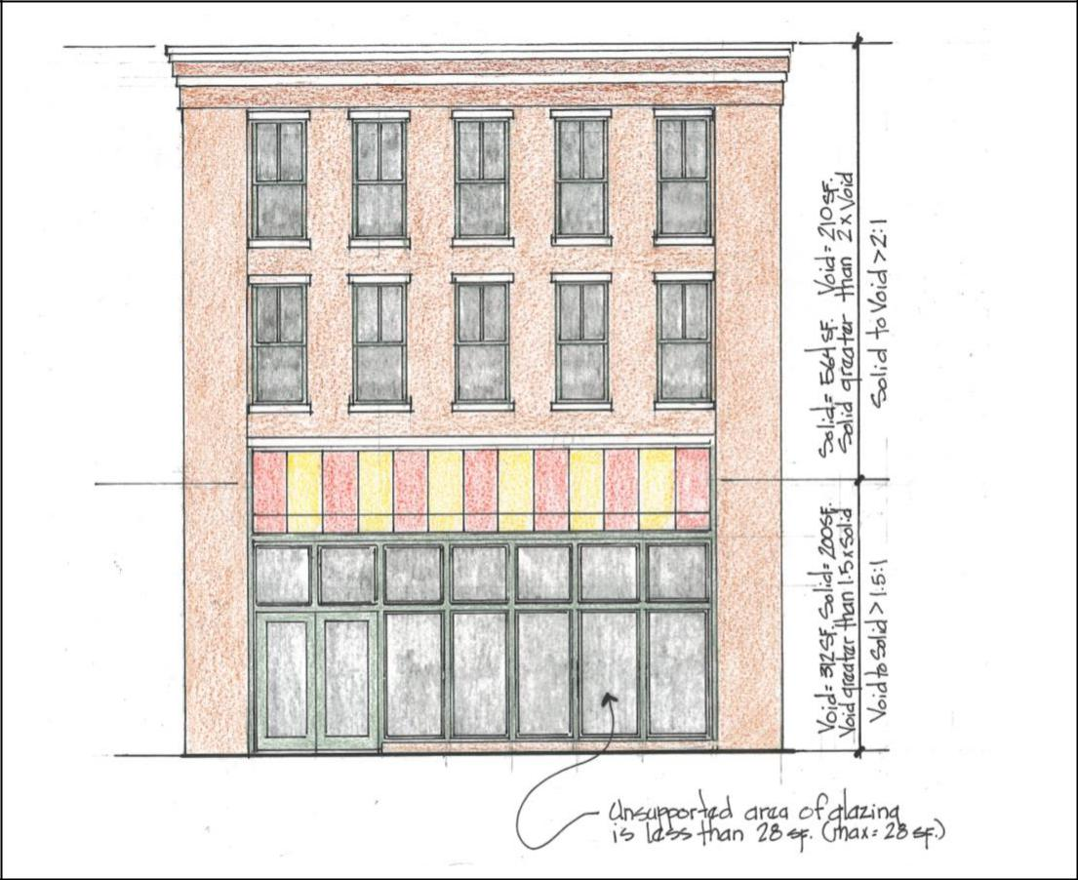
EXCERPT FROM TRANSIT DISTRICT DESIGN STANDARDS

Slide 11
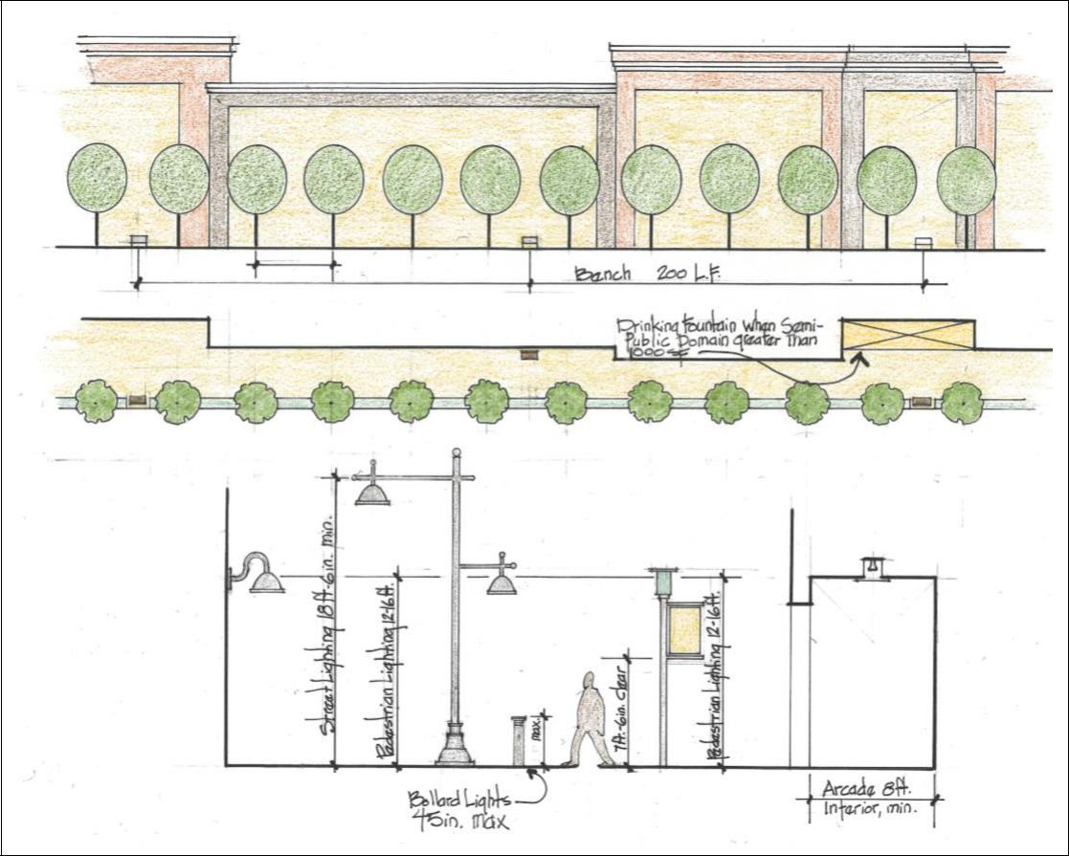
EXCERPT FROM TRANSIT DISTRICT DESIGN STANDARDS

Slide 12
TRANSIT DISTRICT SIGN STANDARDS

Slide 13
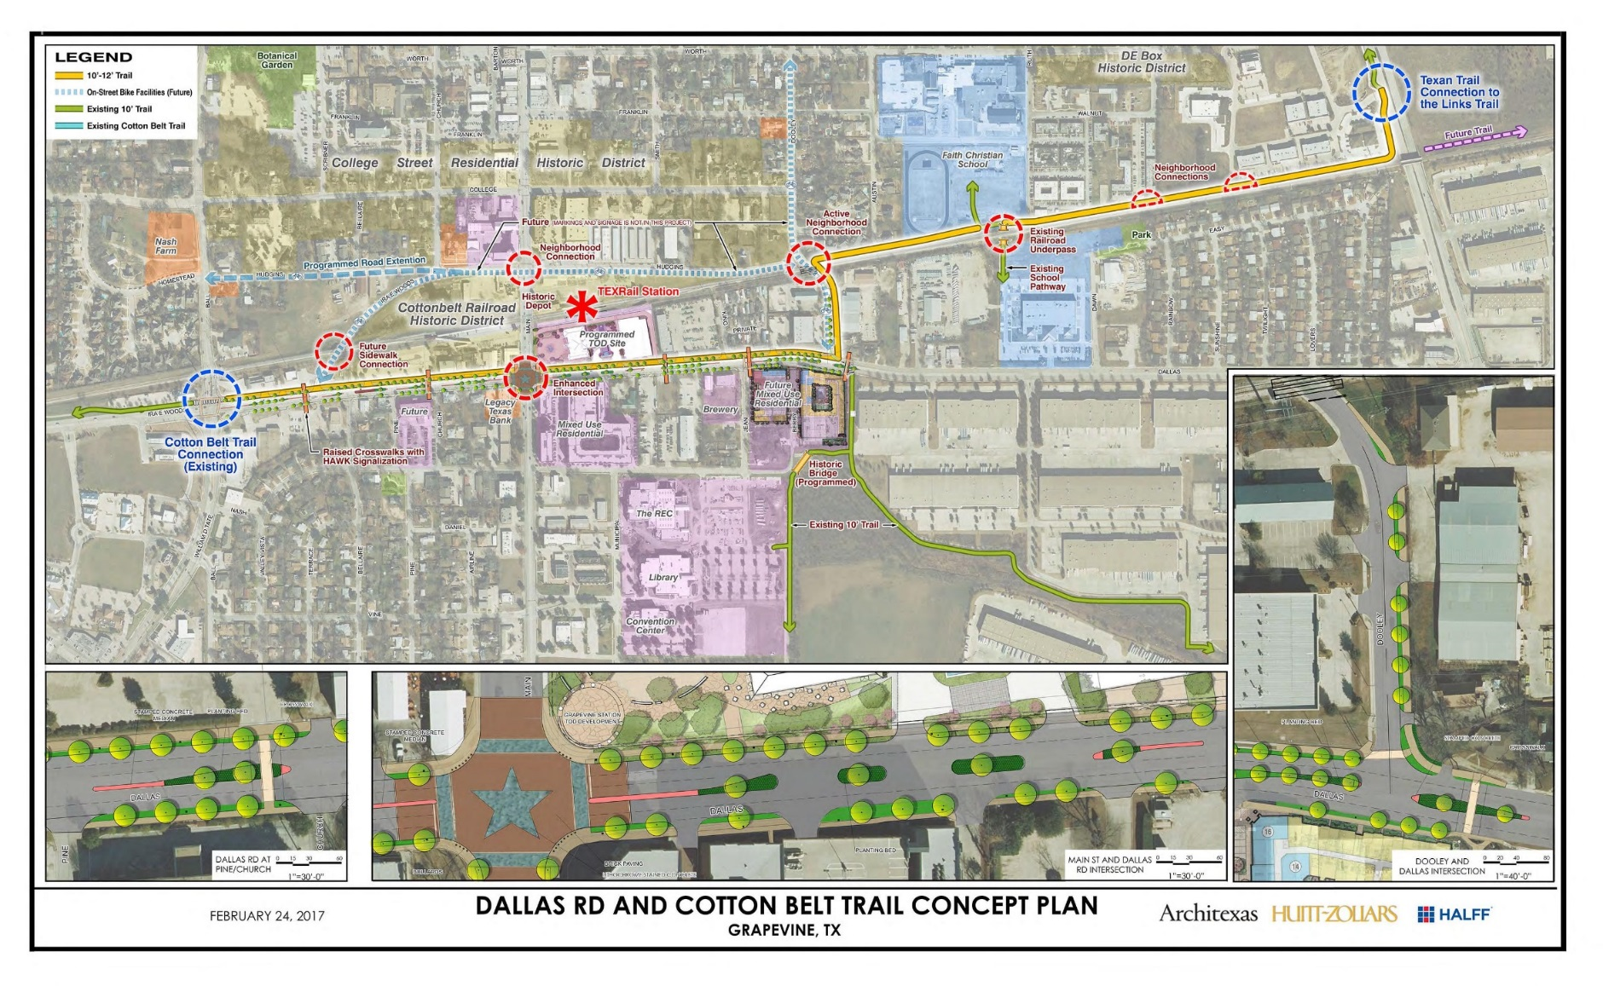
DALLAS ROAD IMPROVEMENTS/HIKE & BIKE TRAIL

Slide 14
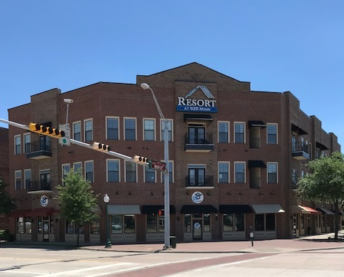
TRANSIT DISTRICT CONTRIBUTING PROPERTIES

Slide 15
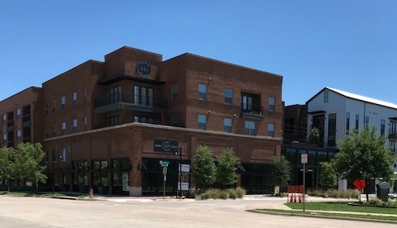
TRANSIT DISTRICT CONTRIBUTING PROPERTIES

Slide 16
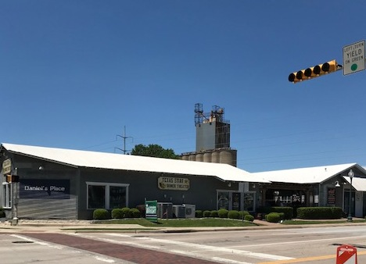
TRANSIT DISTRICT CONTRIBUTING PROPERTIES

Slide 17
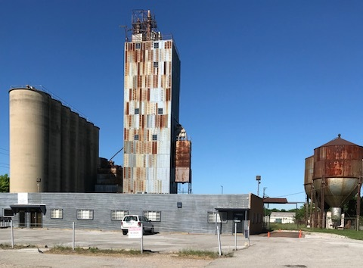
TRANSIT DISTRICT CONTRIBUTING PROPERTIES /REDEVELOPMENT OPPORTUNITIES

Slide 18
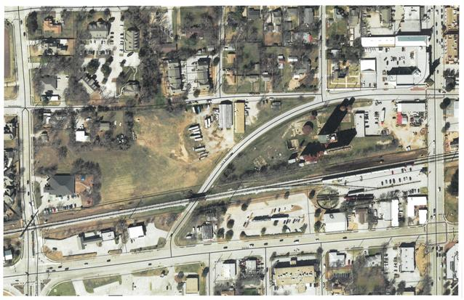

Slide 19
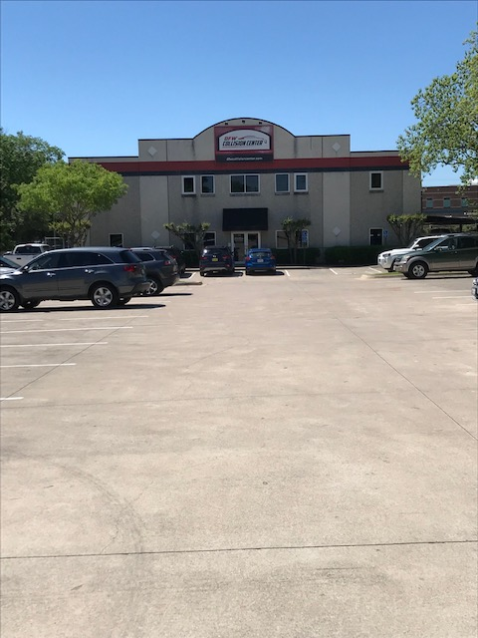
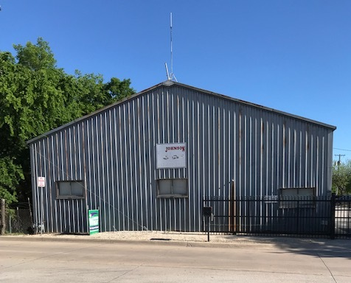
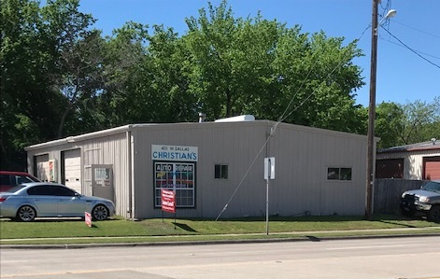
TRANSIT DISTRICT REDEVELOPMENT OPPORTUNITIES

Slide 20
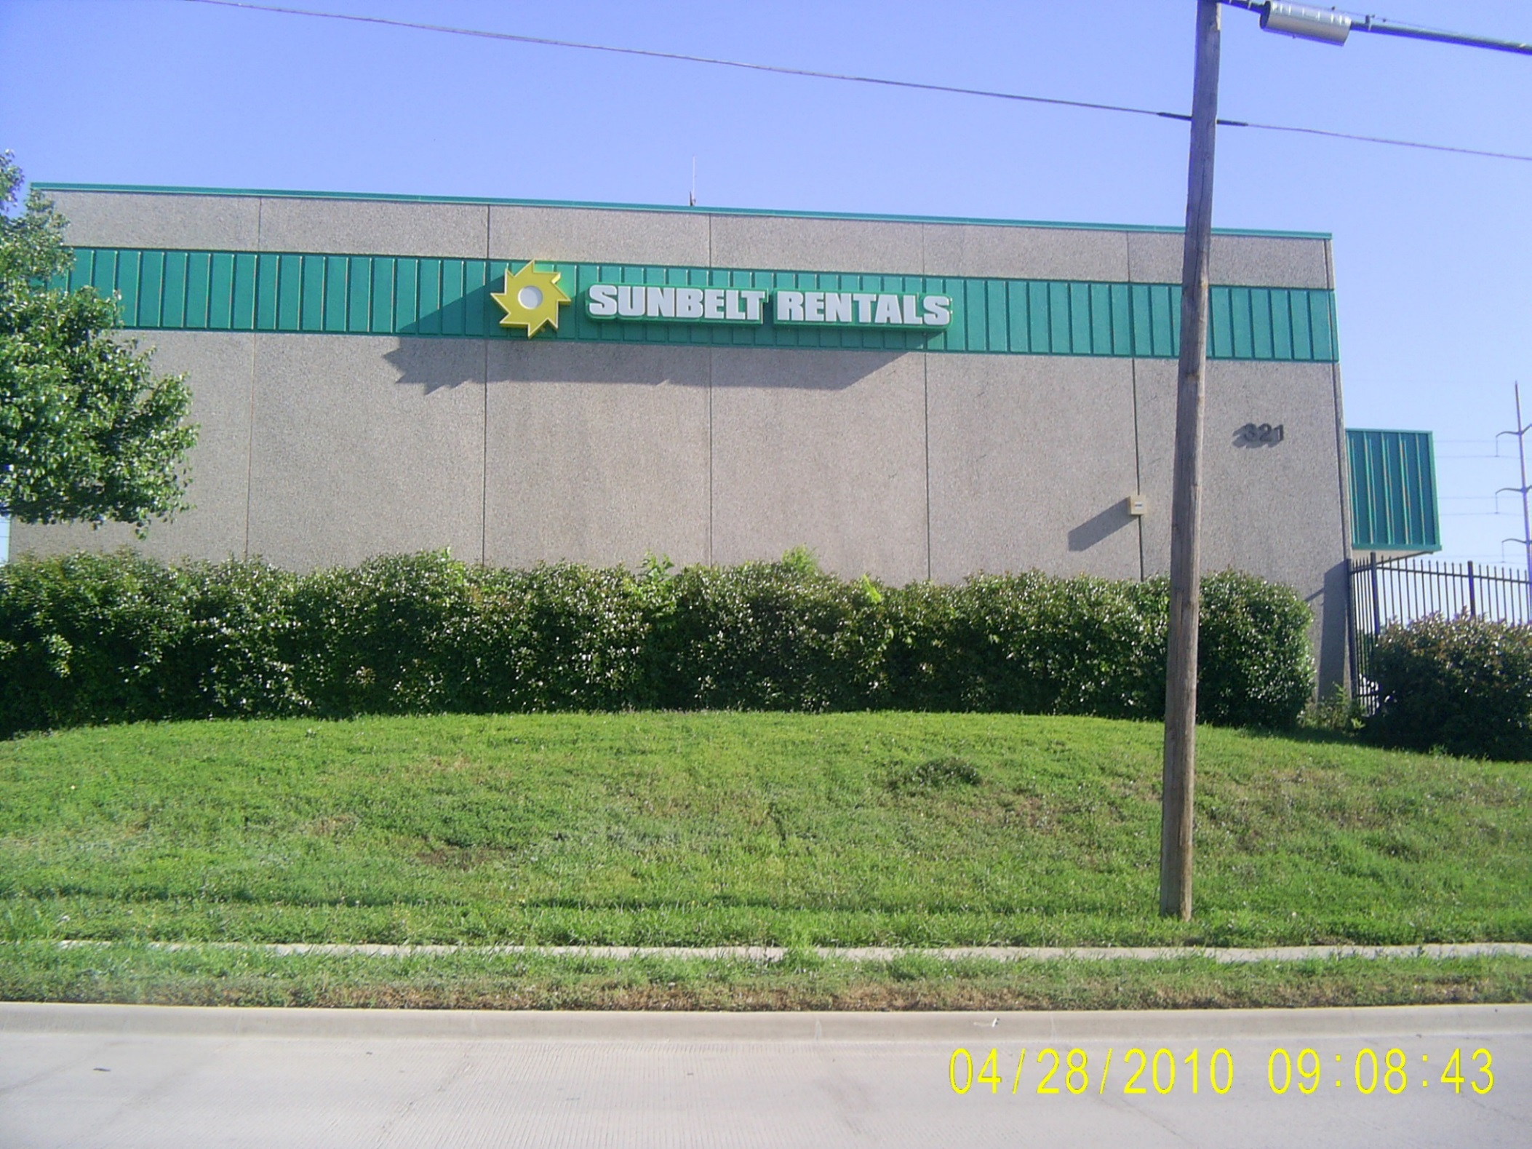
TRANSIT DISTRICT REDEVELOPMENT OPPORTUNITIES

Slide 21
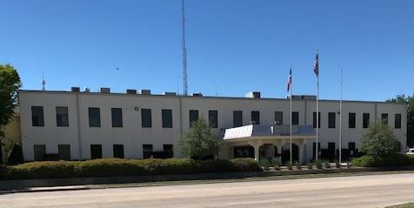
TRANSIT DISTRICT REDEVELOPMENT OPPORTUNITIES

Slide 22
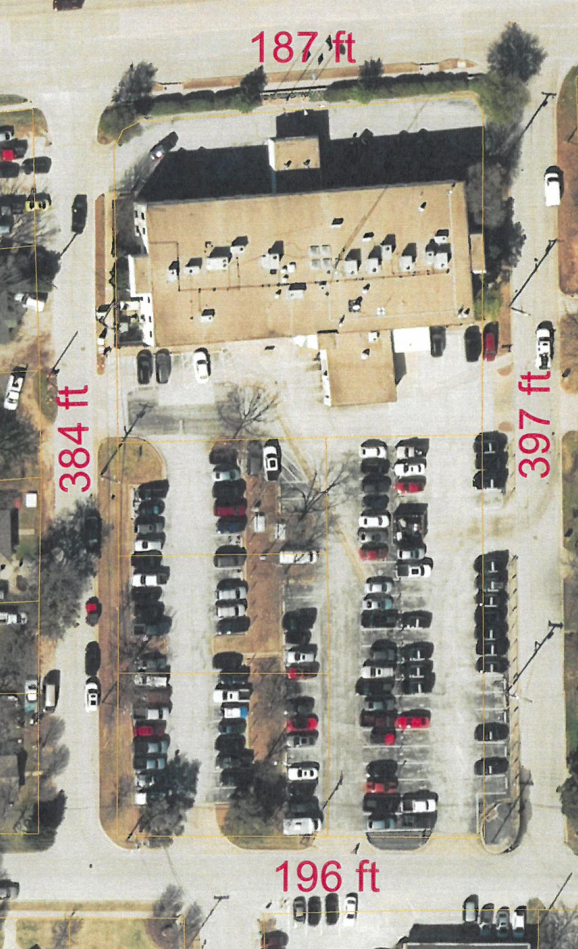
TRANSIT DISTRICT REDEVELOPMENT OPPORTUNITIES
City Owned Property 307 West Dallas Road - Approximately 26,580 sf and 1.7 acres

